Slide 1

String Methods

Slide 2

Reference
Corey Schafer’s Youtube
Youtube
Code

Slide 3
String Methods

Slide 4
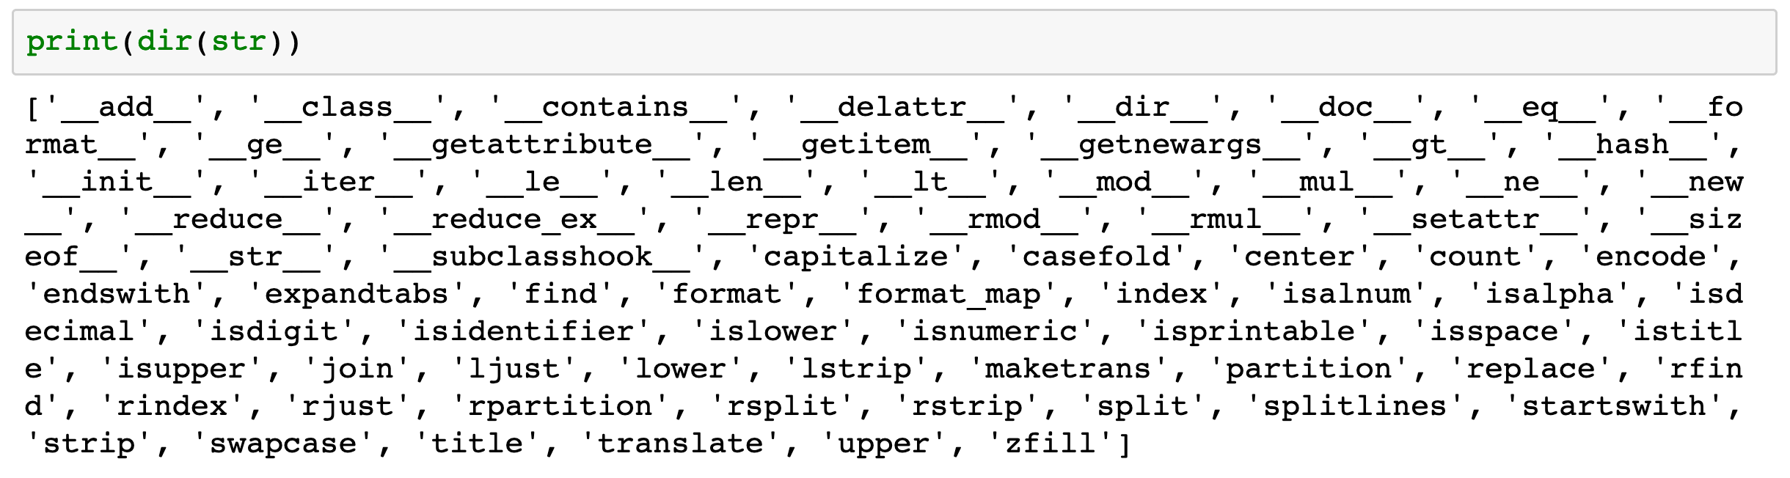

Slide 5
lower, upper, capitalize, and replace

Slide 6
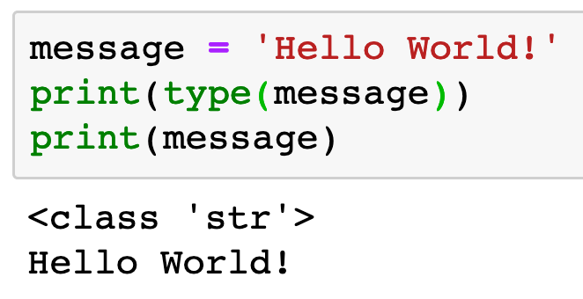

Slide 7
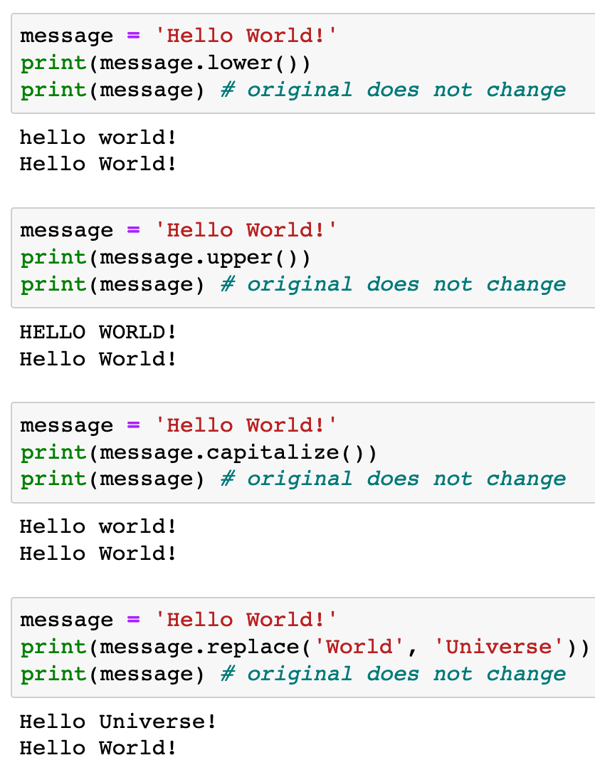


Slide 11
How to change original - failed attempt

Slide 12
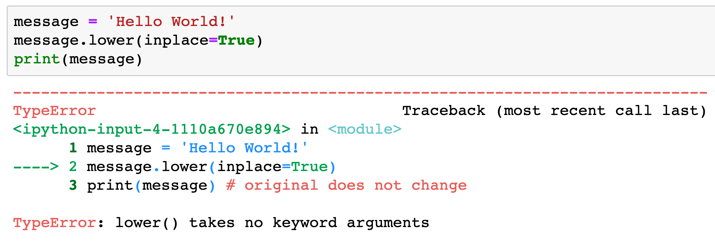

Slide 13
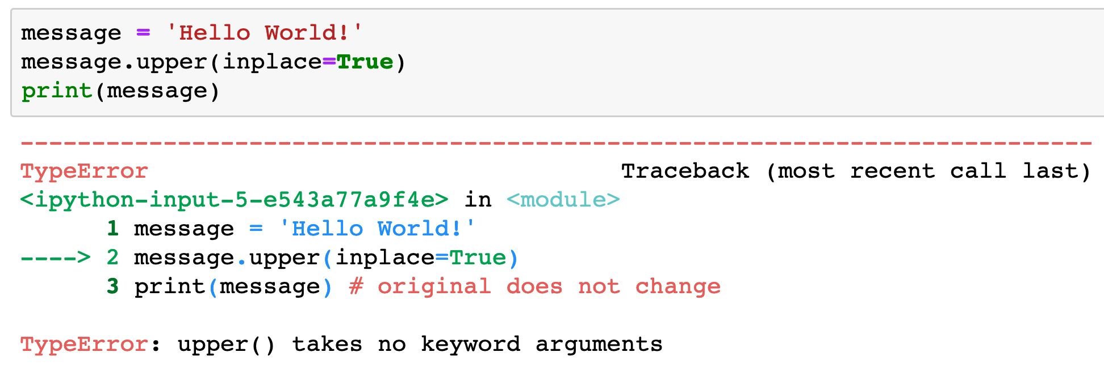

Slide 14
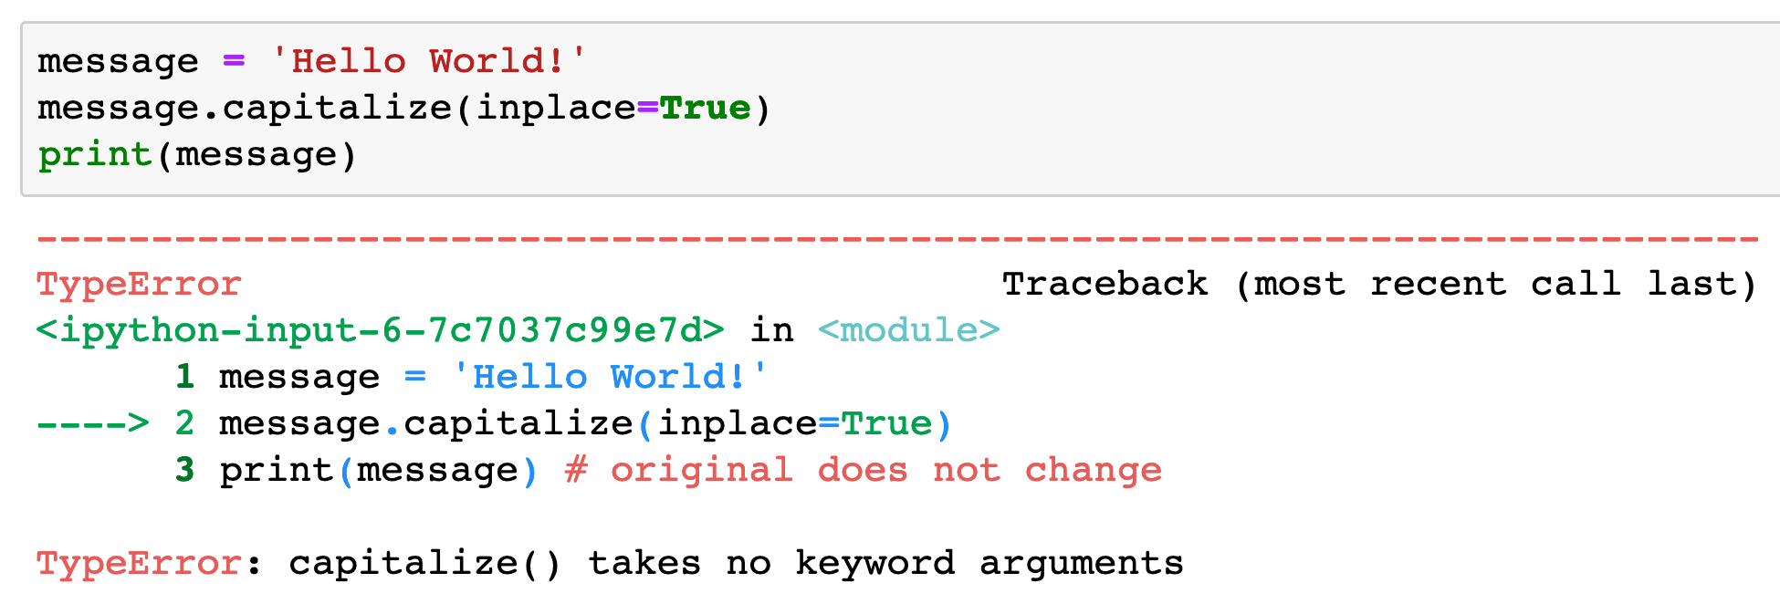

Slide 15
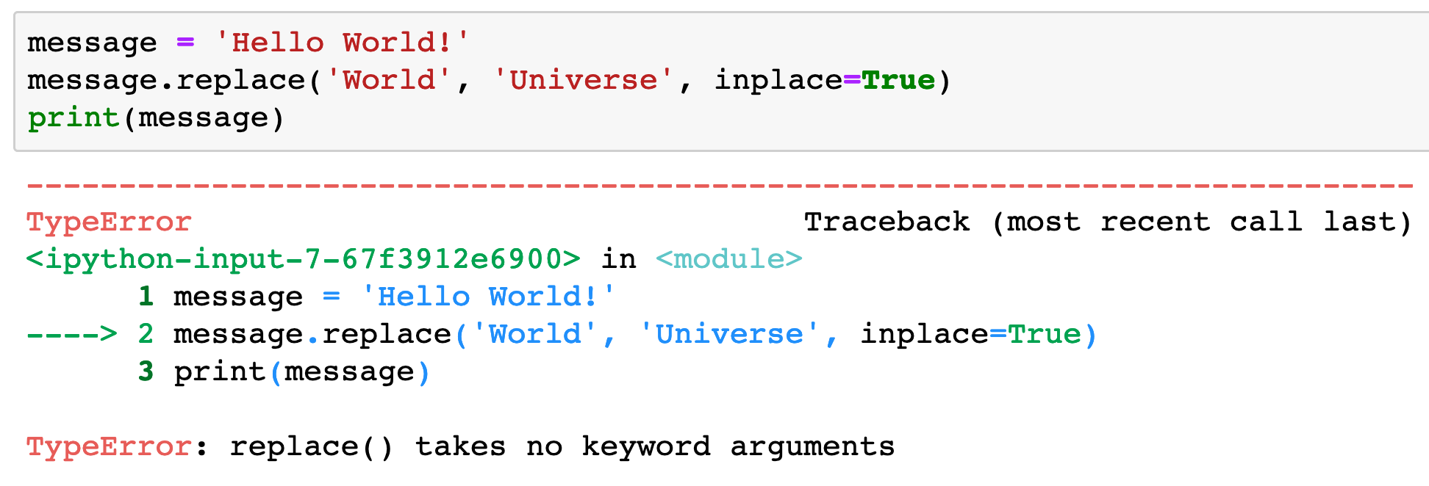

Slide 16
How to change original - Success!

Slide 17
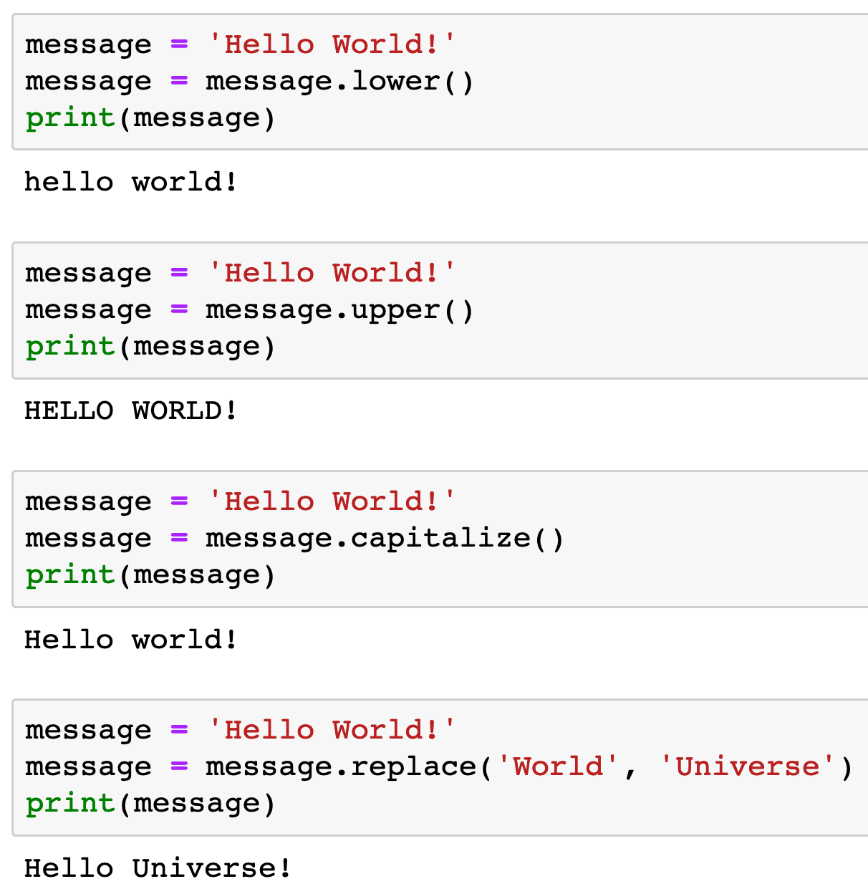

Slide 21
count

Slide 22
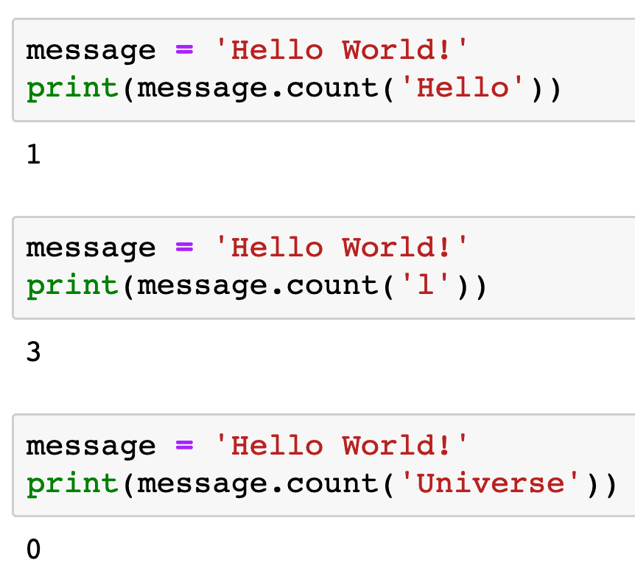

Slide 25
find

Slide 26
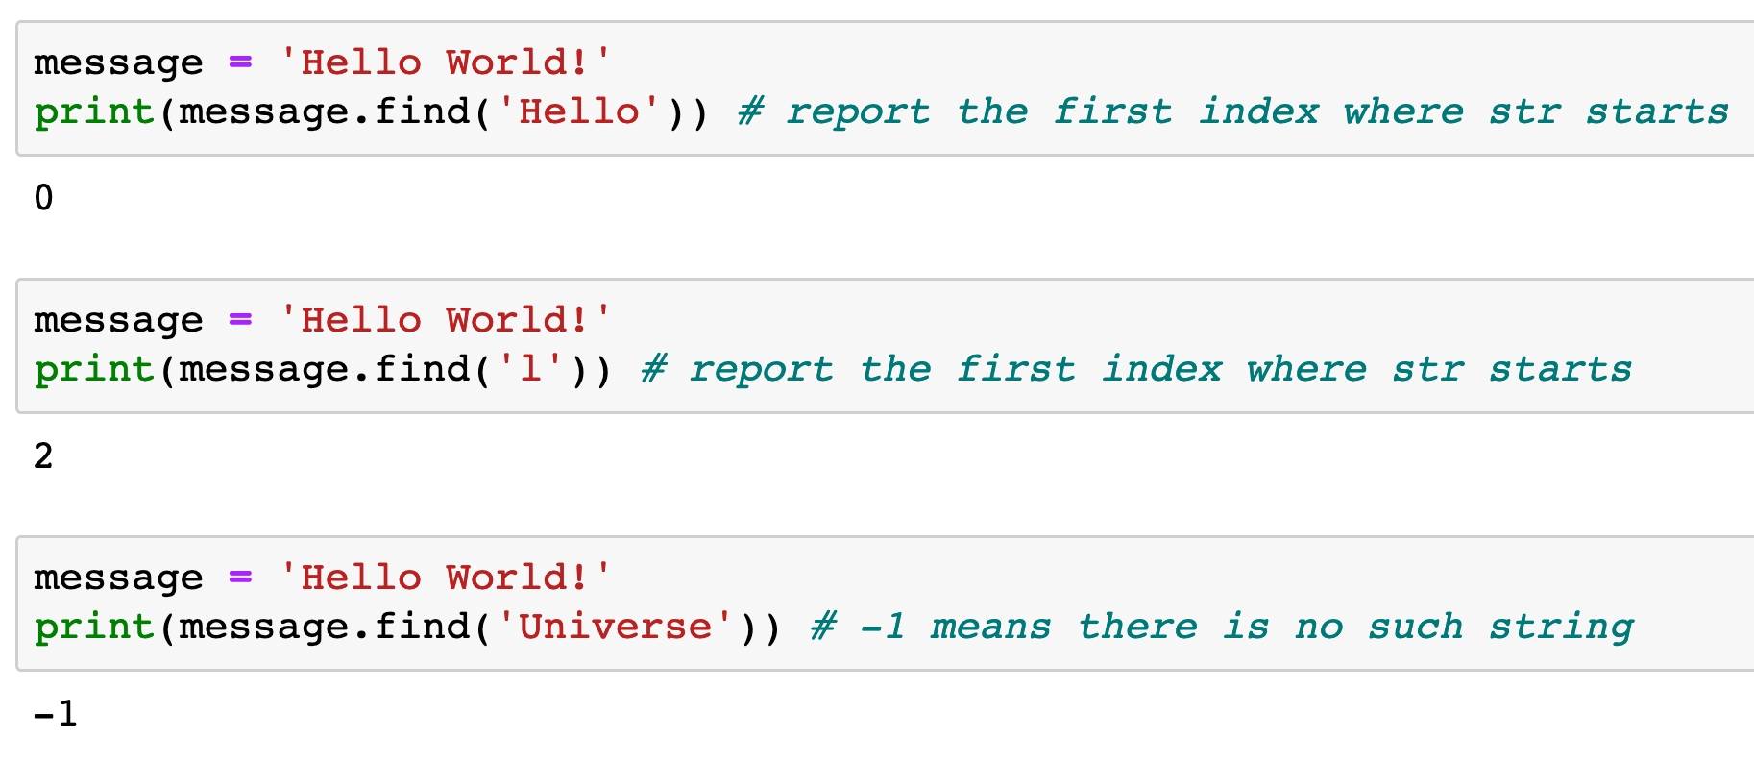

Slide 29
join and split

Slide 30
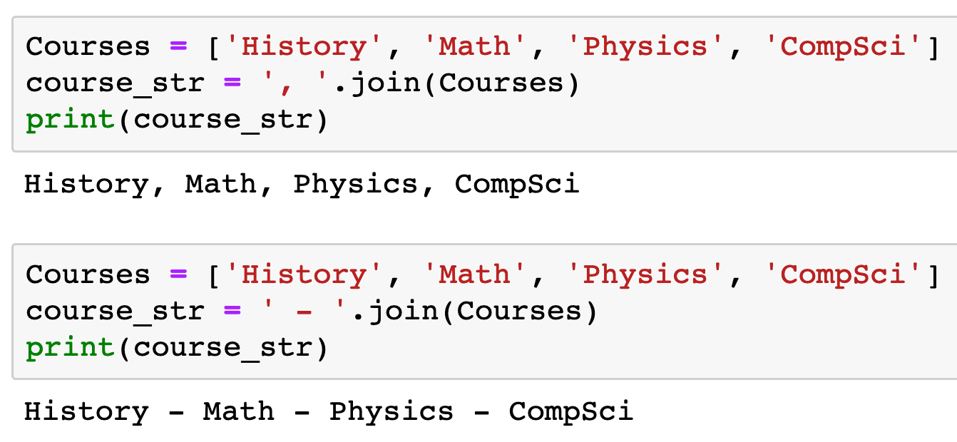

Slide 32
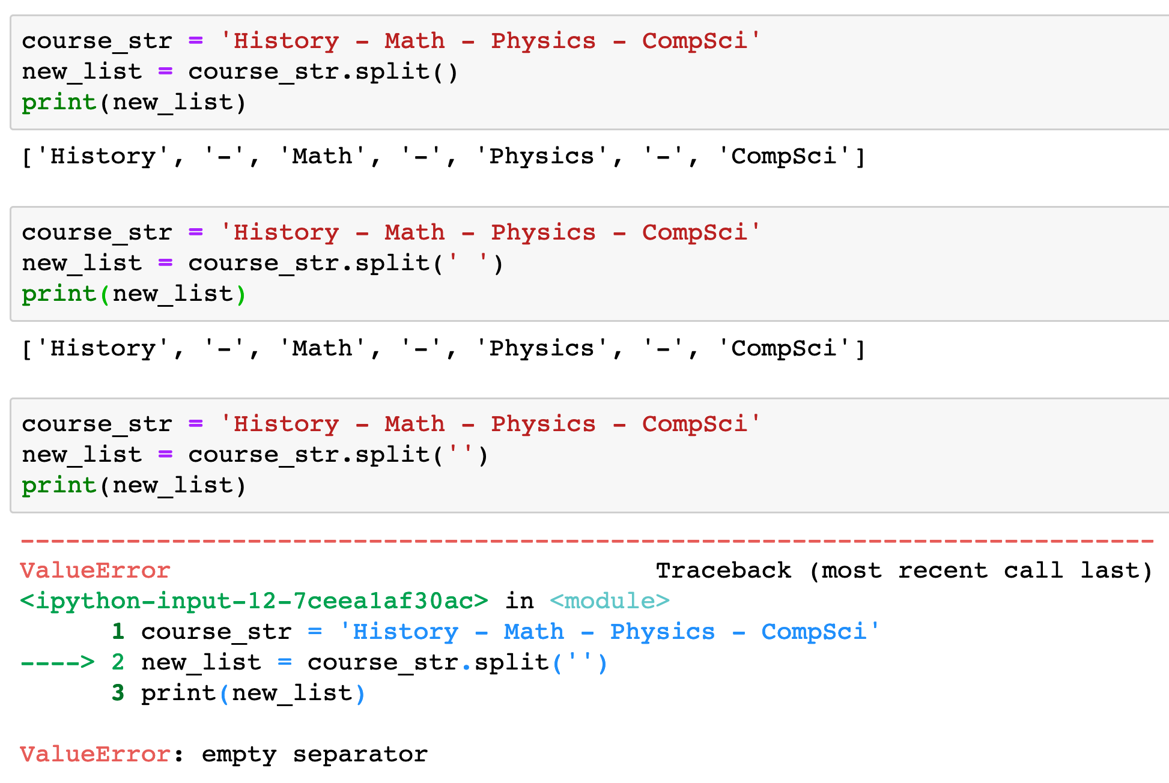

Slide 35
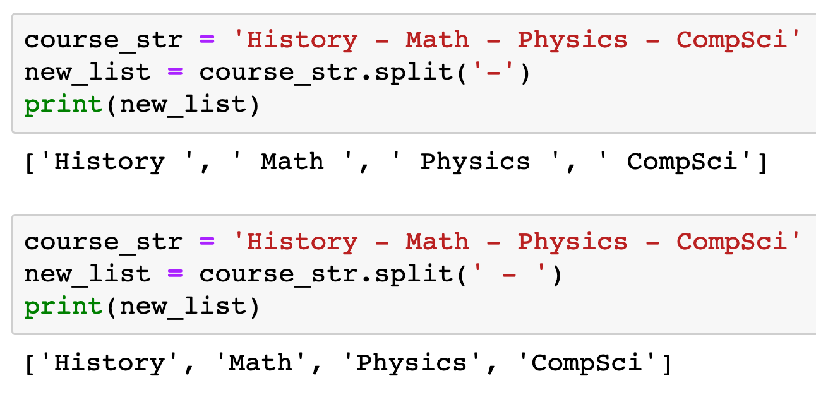

Slide 37
Now
Let’s Play with Code

